Slide 1
Transactional

Slide 2

Transaction
Definition
A logical, atomic unit of work that contains one or more SQL statements
the word atom comes from a Greek word meaning something that cannot be split up any further
SQL Statement 1
Transaction
SQL1
SQL2
SQL3
commit
SQL Statement 2
error
rollback(undo)
SQL Statement n

Slide 3
Transaction
ACID
Atomicity
All tasks of a transaction are performed or none of them are
All or nothing → a, b, c(O) a, b, c(O) a, b, c (X)
Consistency
Preserve correct status → does not violate constraints and rules
Correct status exam
Balance(money) should be more than 0
High school grades range from 1 to 3
Primary key cannot have null or duplicate values
correct status
Transaction
correct status

Slide 4
Transaction
ACID
Isolation
Concurrent execution of transactions leaves the database in the same state that would have been obtained if the transactions were executed sequentially
Durability
Guarantees that once a transaction has been committed, it will remain committed even in the case of a system failure (e.g., power outage or crash)
Transactions (or their effects) are recorded in non-volatile memory
→
DB state
TS1
TS2
TS3
=
TS1
TS2
DB state
TS3
→
Transaction
changes are still queued in the disk buffer waiting to be committed to disk
1
2
3
outage
commit

Slide 5
With JDBC API
try{
conn.setAutoCommit(false); (Insert, Update, Delete)..
(Insert, Update, Delete).. conn.commit(); catch(SQLException e) {
e.printStackTrace(); if( conn != null )
try { conn.rollback(); //if error occurs → rollback
} catch(SQLException sqle) {}
} } finally {
try { conn.setAutoCommit(true);
if( pstmt != null ) pstmt.close(); if( conn != null ) conn.close();
} catch (SQLException sqe) { } }
True → All SQL statements are executed as separate transactions
jdbc는 기본적으로 setAutoCommit()이 true로 설정되어 있으므로
commit과 rollback을 지정하기 위해서는
다음과 같은 코딩 스타일을 관례적으로 사용

Slide 6
Isolation
Isolation level
The weaker the isolation level, the more anomalies can occur
Read Uncommitted(level 0)
Read Committed(level 1)
Repeatable Read(level 2)
Serializable(level 3)
value
READ_UNCOMMITTED
READ_COMMITTED
REPEATABLE_READ
SERIABLIZABLE
integrity
performance
 | Dirty Read | Non-Repeatable Read | Phantom Read
Read Uncommitted | O | O | O
Read Committed | X | O | O
Repeatable Read | X | X | O
Serializable Read | X | X | X

Slide 7
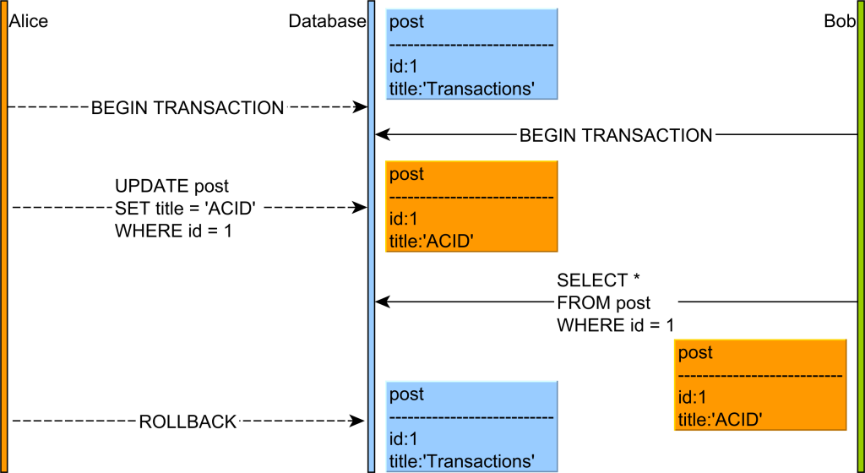
Isolation
Read Uncommitted
(Problem) Read unreliable data(Dirty Read)
not yet committed

Slide 8
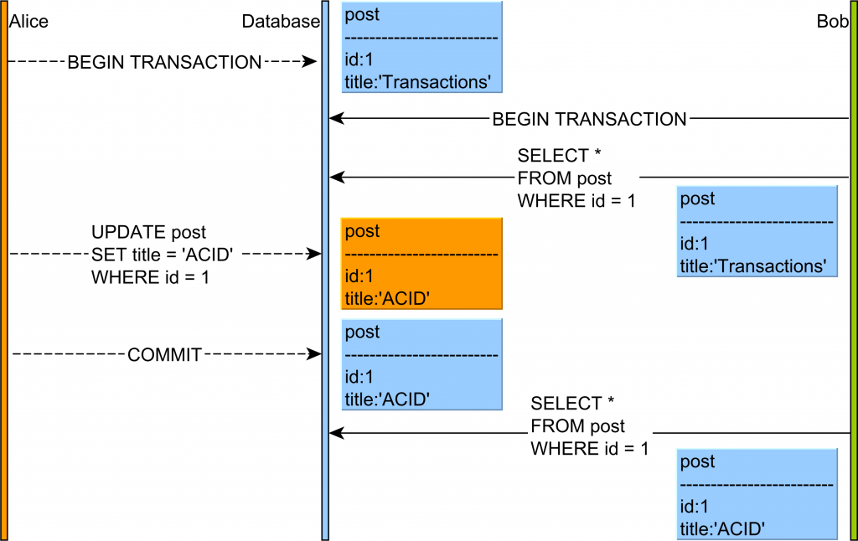
Isolation
Read Committed
(Problem) The results with the same select query are different within a transaction(non-repeatable read)
update or delete is possible
already read by Bob

Slide 9
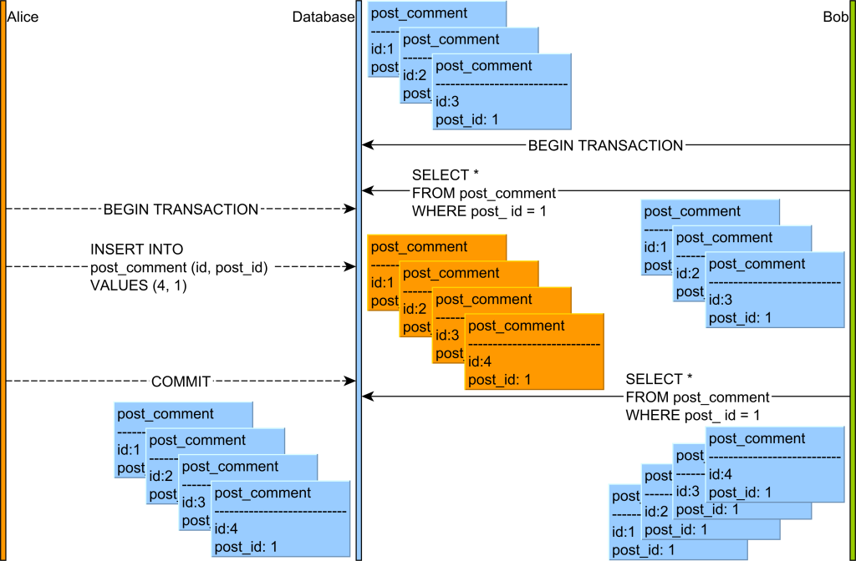

Isolation
Repeatable Read
(Problem) New rows are added or removed by another transaction(non-repeatable read)
Serializable read
→ Insert is also impossible
update is impossible
but, insert is possible

